Slide 1

Keeping the Fight Alive
by Robert Smith
Yuying Hong
Madhav Srivastava

Slide 2


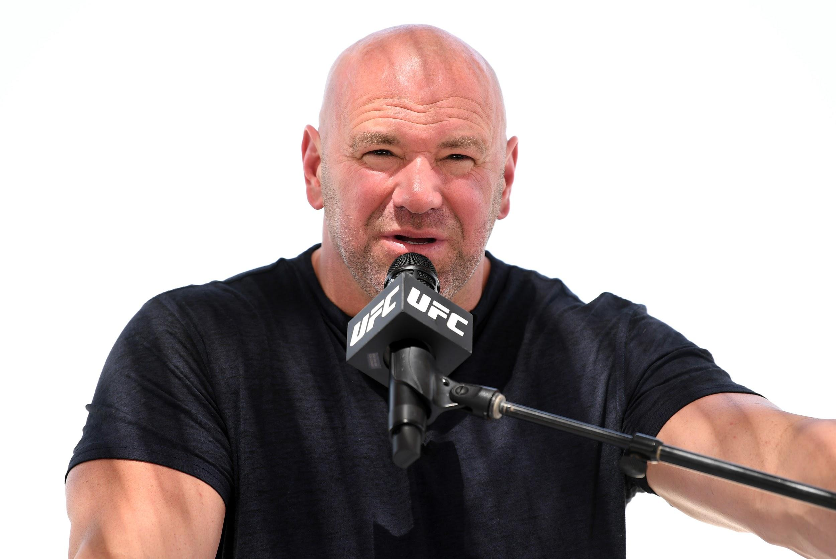
Yas Island, Abu Dhabi
“We’re Going to make history”
-Dana White, President of UFC

Slide 3



Slide 4
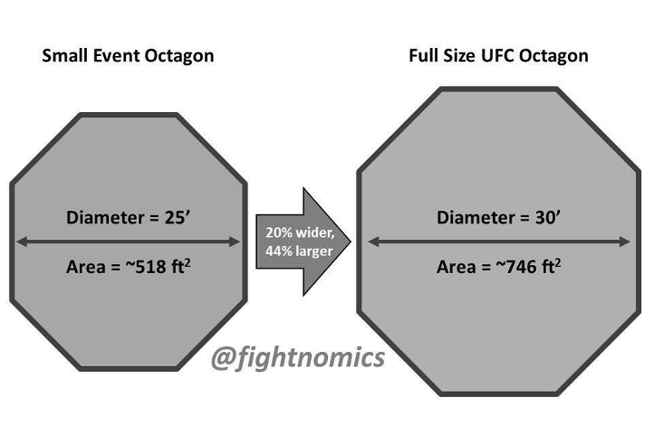
UFC Cage Size Decreased since COVID

Slide 5
UFC Cage Size Decreased since COVID
We will compare results between:
Pre COVID
During COVID

Slide 6
Decreased Cage Size: Does it make a difference?
See change in
Decision
KOs
Submissions

Slide 7
Decreased Cage Size: Does it make a difference?
See Change in
Significant Strikes
Significant Striking Accuracy
Average Submission Attempted
Average Takedown Accuracy
Average Takedowns/ 15 mins

Slide 8
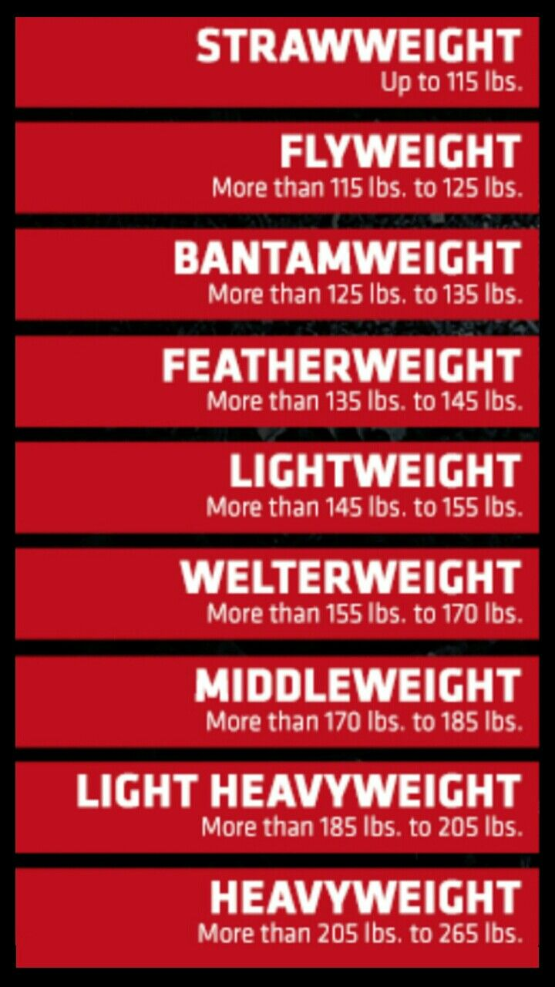
Any Changes in Results by Weight Class?
-TKOs
-Submissions
-Decisions

Slide 9
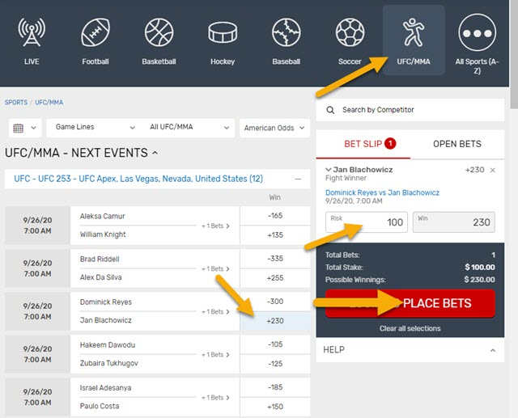
Have betting odds gotten more accurate since COVID?

Slide 10
Data Exploration
Sources of Three Datasets
Fight Result
Manually → ufcstats.com
Event Details & Fight Stats
API → sportsdata.io
CSV import → kaggle
Data Time Range
Pre & During COVID
2020

Slide 11
Data Exploration: No Data
ESPN API on viewership
Data on fighters nationality

Slide 12
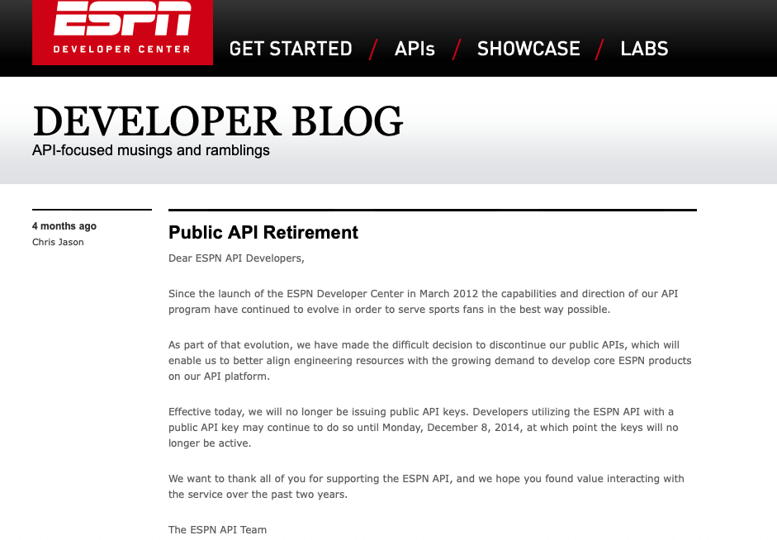
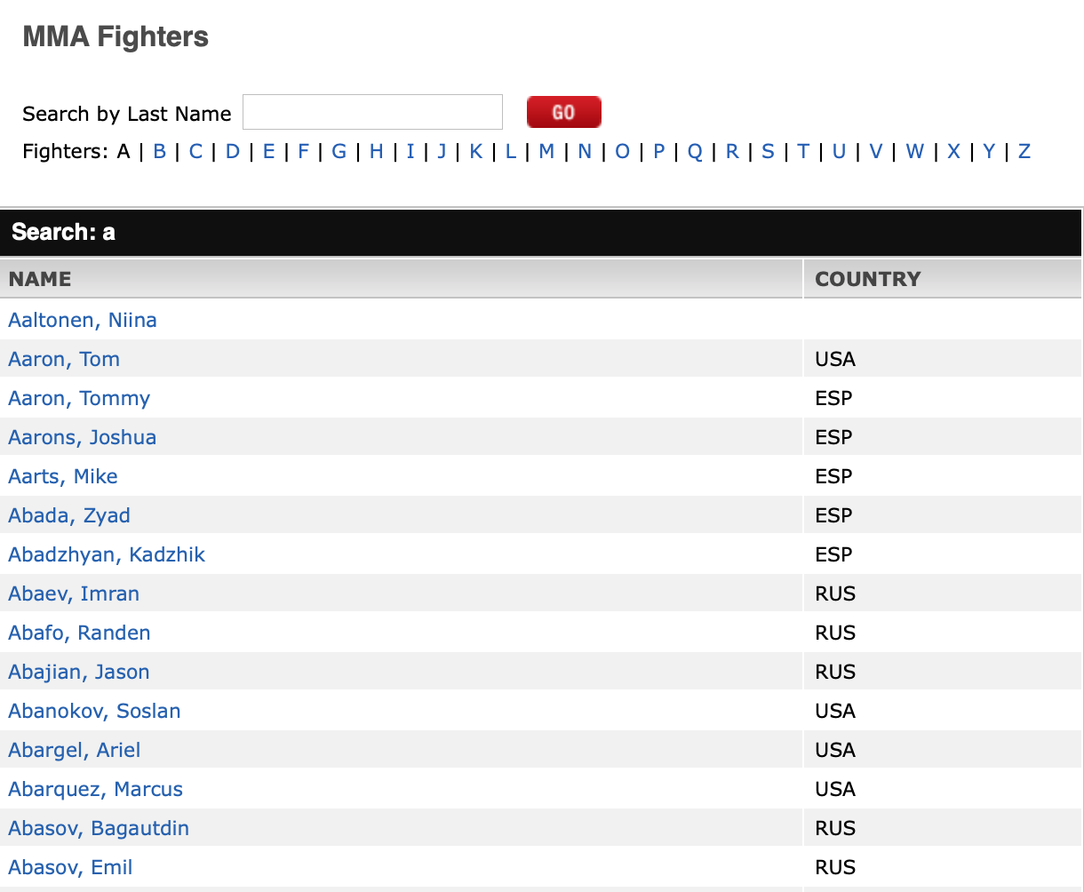

Slide 13
Data Exploration:
Fight Result - No Data 2
No exportable data on fight information
Solution....
Manually input the data!

Slide 14
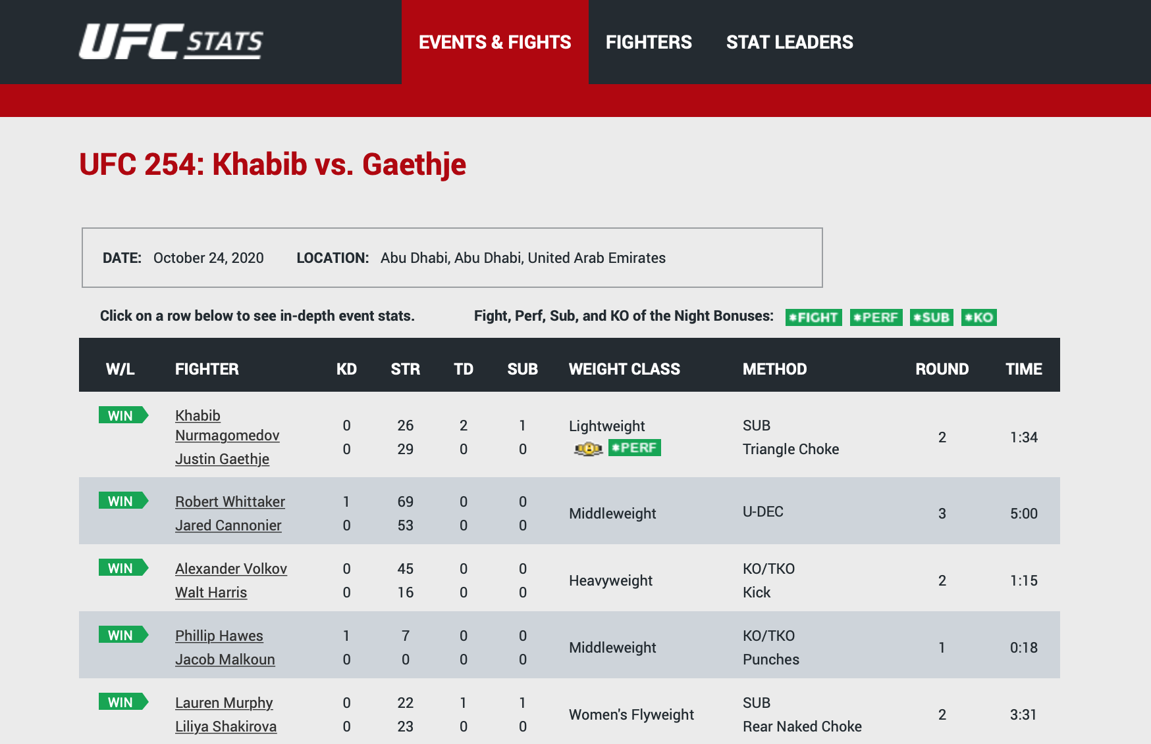
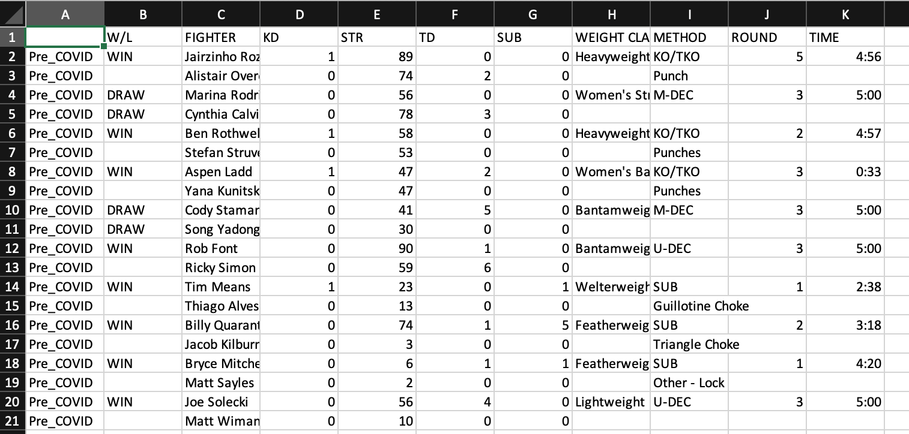

Slide 15
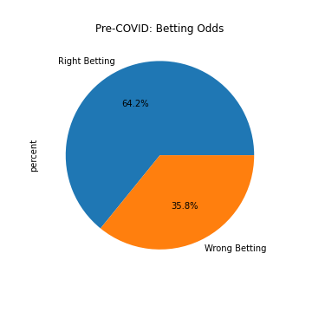
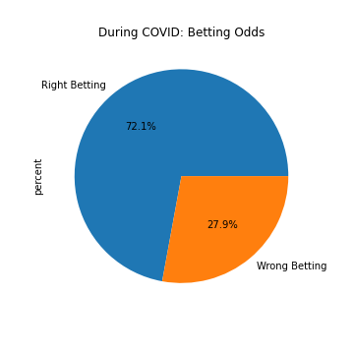

Slide 16
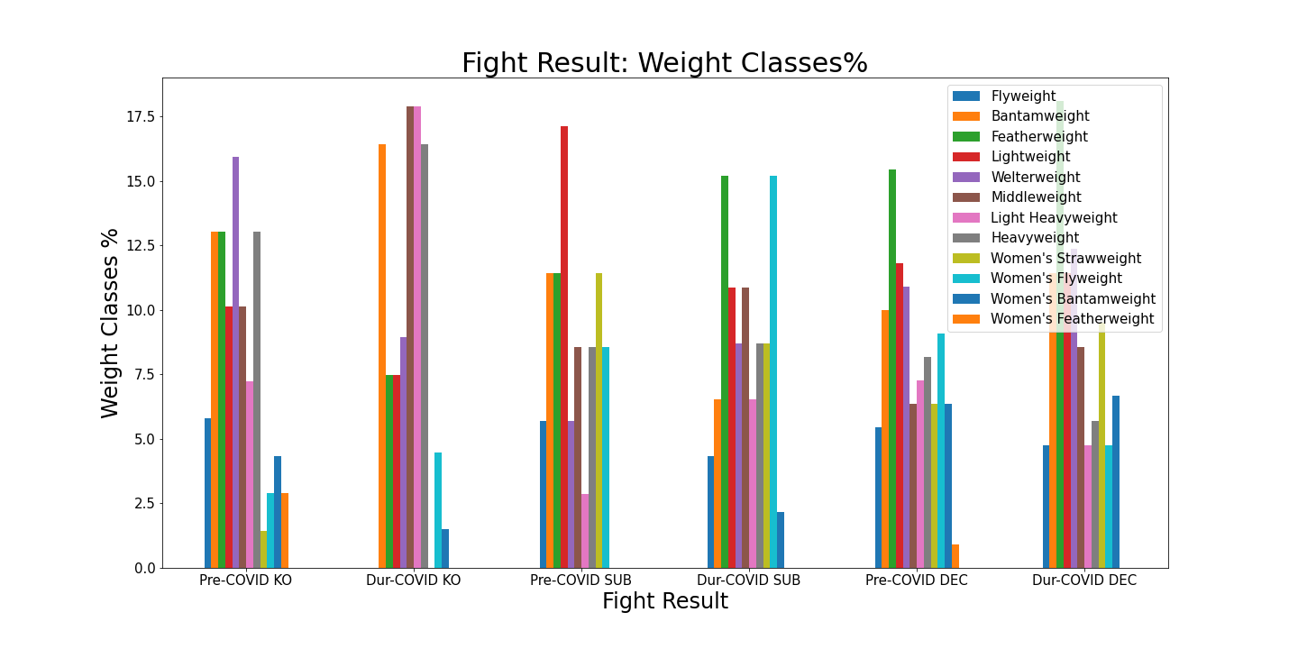

Slide 17
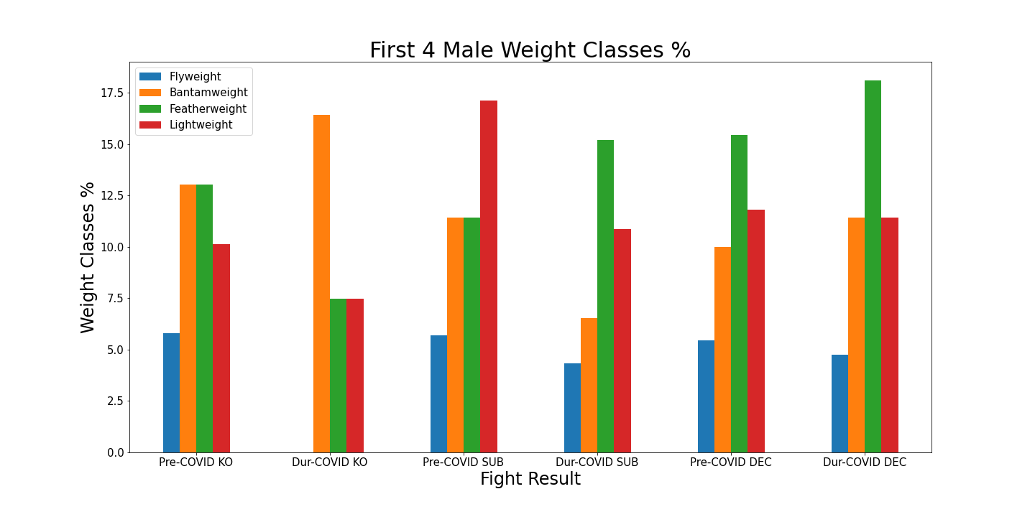

Slide 18
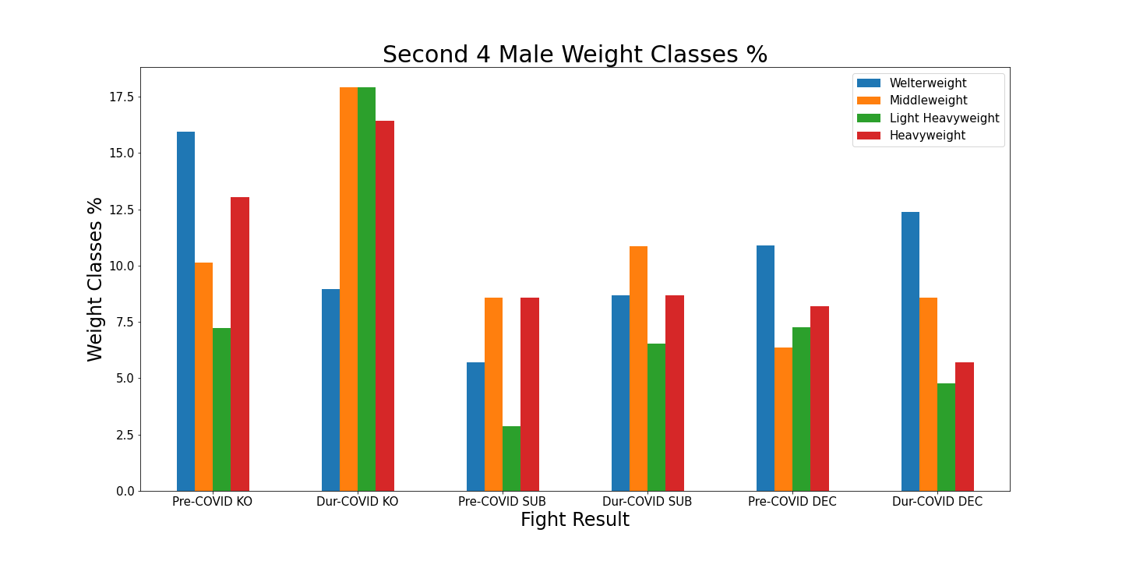

Slide 19
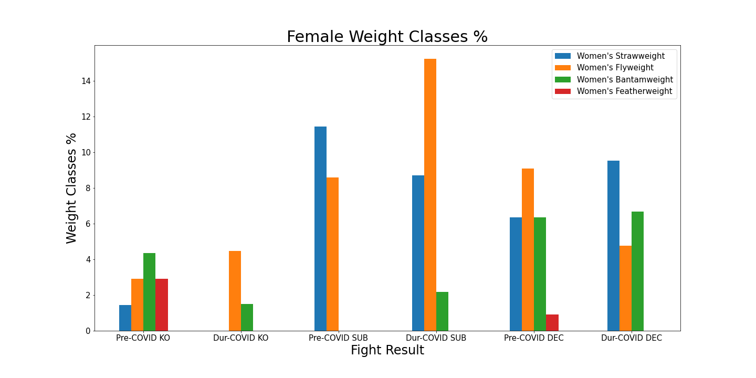

Slide 20


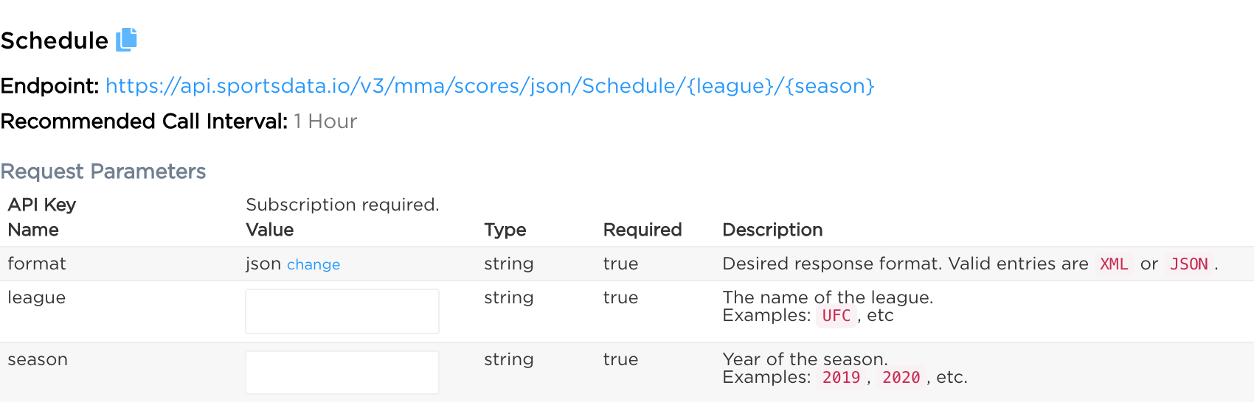
Data Exploration:
MMA Event Details
sportsdata.io
→ Event Details

Slide 21
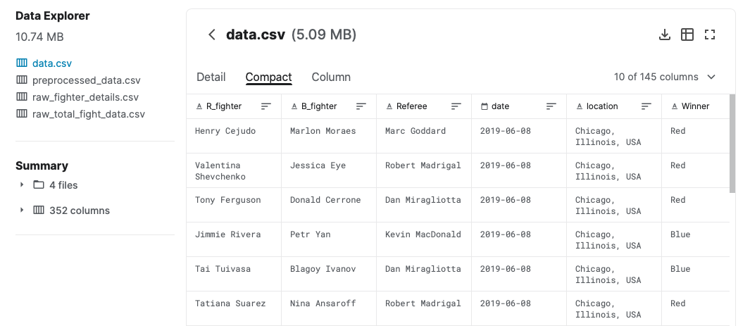
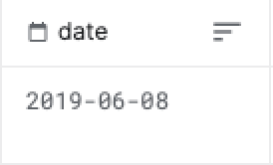
Data Exploration:
MMA Fight Stats
Kaggle
→ CSV file
But…
Only contains data up to 2019

Slide 22
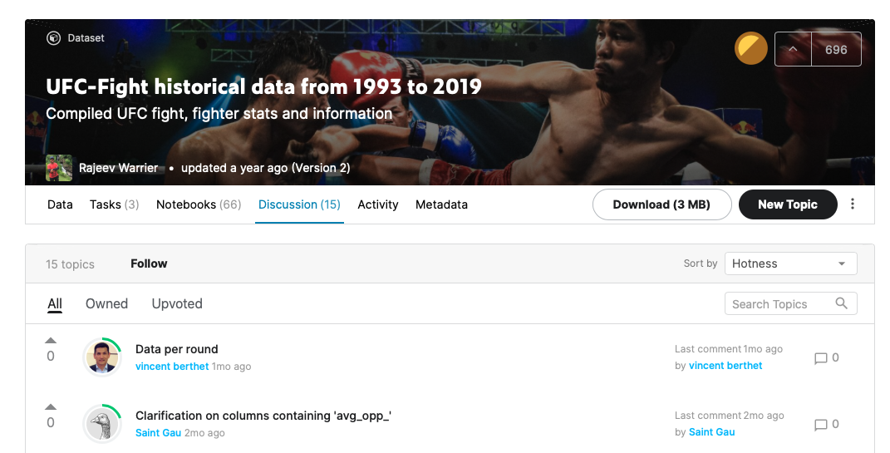
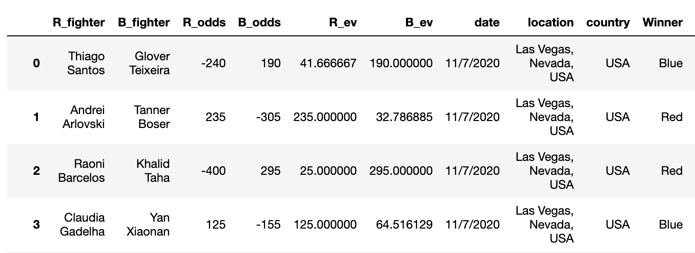
SOLUTION!

Slide 23
Data Cleanup
Two from sportsdata.io
Ended up using only one
One from Kaggle
Three Sets of Data

Slide 24
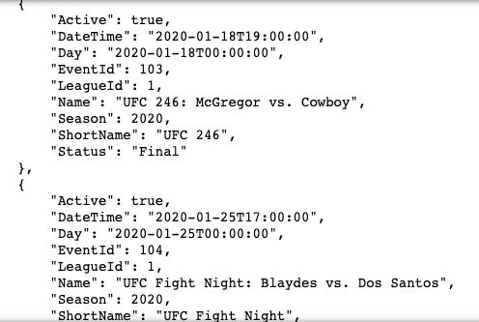
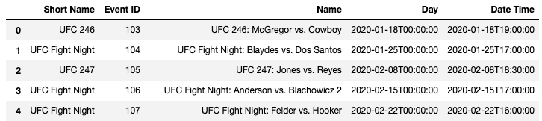
Data Cleanup:
MMA Event Details
For loop to extract all the wanted data
Converted to dataframe
Removed unneeded data:
Dana White’s Contender Series
Canceled events
Scheduled events

Slide 25
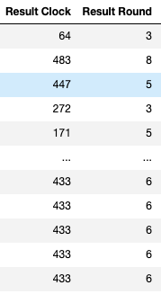
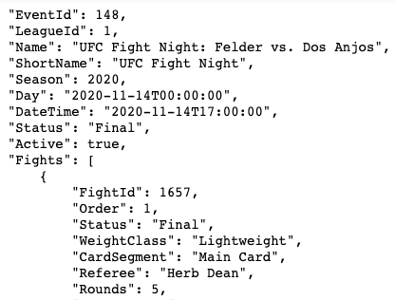
Data Cleanup:
MMA Score Details
For loop
More for loops
Columns “Result Clock” & “Result Round” have confounding values
Removed these two columns

Slide 26
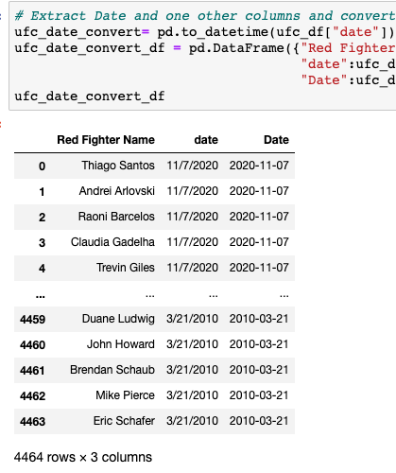
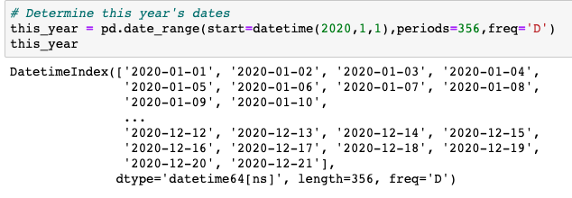
Data Cleanup:
CSV File from Kaggle
Kept and renamed the columns we want
Converted the dates to datetime format
Defined date range using pd.date_range
Merged dataframes
Dropped null values

Slide 27
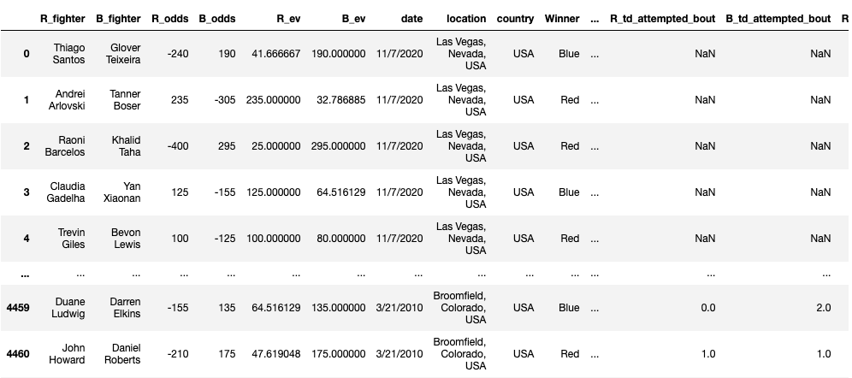
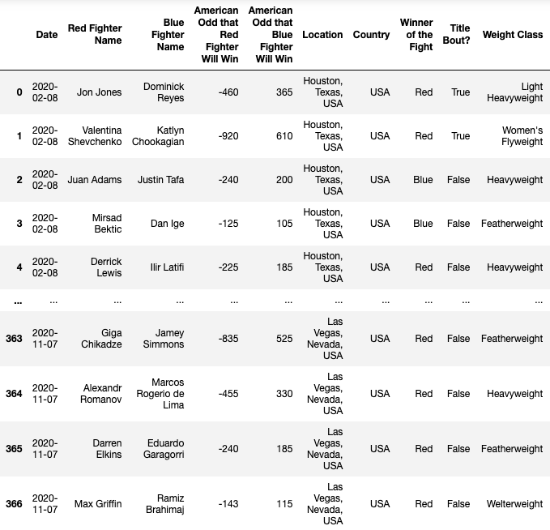
BEFORE
AFTER →

Slide 28
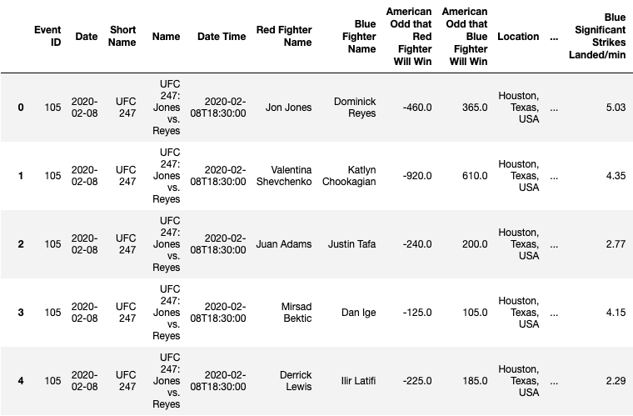
Data Cleanup:
Combining Datasets
MMA Event Data → datetime
Merged dataframes
Dropped null values

Slide 29
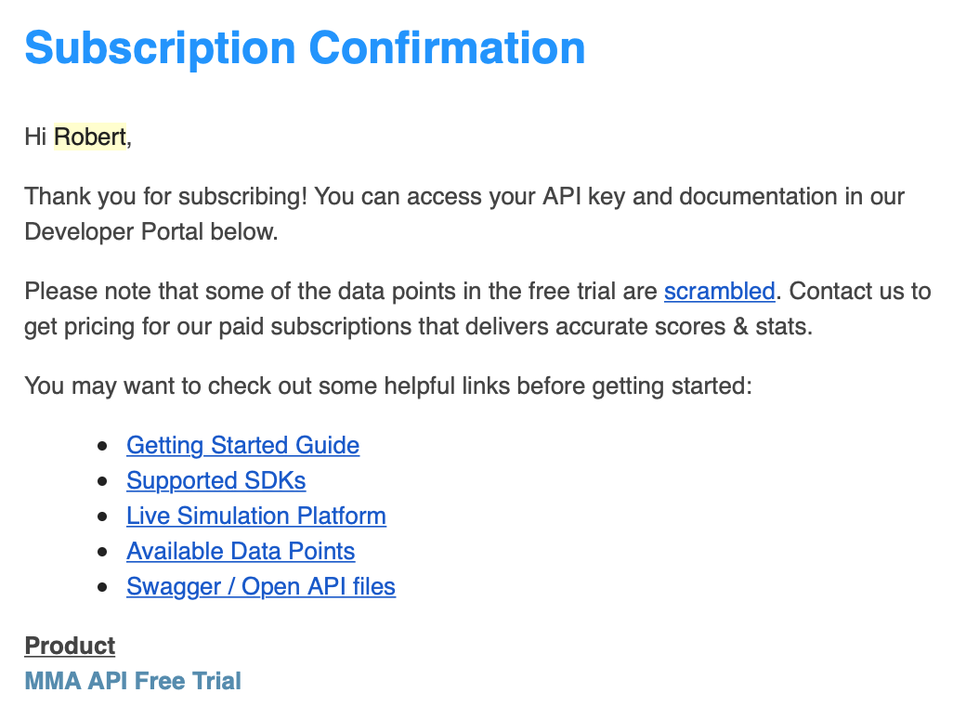
Difficulty
Combining the score dataset with the already combined datasets
Only one common column→ “Date”
Many failed attempts…
Scrambled data
Not using the score dataset

Slide 30
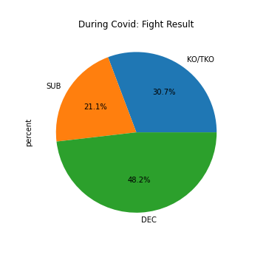
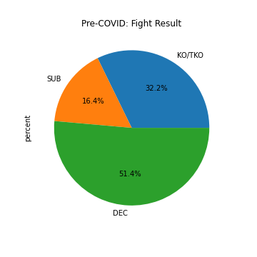

Slide 31
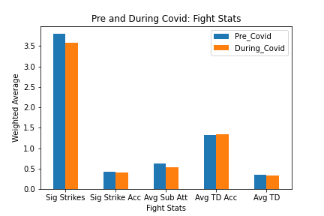
Notes:
Have the fights changed?
Not much change between pre/during covid
Ko’s, sub, dec about the same.
WHich follows Dana Whites statement it will not change.

Slide 32

Re Summarize Results
Decreased Cage Size: Does it make a difference with results
or more action?
Not significant enough!
Any Changes in Results by Weight Class?
For some weight classes, yes!
Have betting odds gotten more accurate since COVID?
Betting odds have been 10% more accurate!

Slide 33

If only we had more time...
Increase Sample Size since 3 more cards have occurred since November 7th.
Data on fighter nationality
Are more international fighters able to fight
Other Organizations to analyze
Bellator
PFL
One Championship
Analyze Dan Whites Contender Series Results

Slide 34

Thank you! Any questions?

